Slide 1
CRYPTOCURRENCY PRICE PREDICTION
RAJESH KUMAR D
PADMANABAN A

Slide 2

INTRODUCTION
Cryptocurrencies have been gaining increasing popularity and attention in recent years, with more and more people investing in them. As with any other financial asset, the price of cryptocurrencies is highly volatile and subject to fluctuations based on a multitude of factors. This presents both opportunities and risks for investors who seek to make informed decisions about buying, holding, or selling cryptocurrencies.
The ability to accurately predict the price of cryptocurrencies is thus highly sought after, as it can help investors make more informed decisions about their investments. In this project, we explore two popular machine learning models - Long Short-Term Memory (LSTM) and XGBoost - for predicting the price of cryptocurrencies, specifically Bitcoin.
We use historical Bitcoin price data to train our models and then evaluate their performance on a testing set. Through this project, we aim to demonstrate the potential of machine learning models for cryptocurrency price prediction and provide a framework for investors and researchers to build upon.

Slide 3
MOTIVATION AND OBJECTIVES
The Cryptocurrency market is a rapidly growing sector with a lot of potential for investors, traders, and enthusiasts. The volatility of the cryptocurrency market makes it challenging to predict future prices accurately. Therefore, there is a need for reliable prediction models that can help in making informed decisions. This project's motivation is to develop a model that can predict the price of Bitcoin accurately and help investors and traders make informed decisions.
The objectives of this "Cryptocurrency Price Prediction" project are to develop a reliable and accurate prediction model for Bitcoin prices. This involves several steps, including data preparation, model training, model evaluation, ensemble stacking, and visualizing results.
Data preparation: Clean and preprocess the raw Cryptocurrency price data for machine learning models.
Model training: Train and fine-tune the chosen models on the preprocessed Bitcoin price data to improve their performance.
Model evaluation: Evaluate the performance of the trained models using evaluation metrics such as MAE, MSE, RMSE, and R-squared.
Ensemble stacking: Combine the predictions of multiple models using ensemble stacking to improve overall predictive performance.
Visualize results: Visualize the actual vs predicted graphs of the models to better understand their performance.

Slide 4
LITERATURE SURVEY
Al-Masri, E., & Ali, F., et.al [2021] [1] Machine Learning and Sentiment Analysis for Cryptocurrency Price Prediction: A Review. Journal of Intelligent & Fuzzy Systems. This paper reviewed the literature on the use of machine learning and sentiment analysis for cryptocurrency price prediction.
Alqahtani, M., & Rezgui, Y., et.al [2022] [2] A Comparative Study of Deep Learning Techniques for Cryptocurrency Price Prediction. The authors compared the performance of various deep learning models, including CNNs, LSTMs, and autoencoders, for cryptocurrency price prediction. The authors found that LSTM-based models achieved the highest accuracy and outperformed other models in terms of profitability.
Chang, et.al [2023] [3] proposed a model for predicting cryptocurrency prices using a deep learning-based algorithm. The model used a combination of CNNs and LSTMs to capture both temporal and spatial features of cryptocurrency prices, and the results showed that the proposed model outperformed several baseline models in terms of accuracy and profit.

Slide 5
LITERATURE SURVEY
Chen, Y., & Yang, Y., et.al [2019] [4] A Long Short-term Memory Neural Network for Cryptocurrency Price Forecasting. Journal of Intelligent & Fuzzy Systems, 37(1), 387-394. The authors proposed a long short-term memory (LSTM) neural network model for cryptocurrency price forecasting. The authors found that the proposed model outperformed other models, such as ARIMA and support vector regression, in terms of accuracy and stability.
Chen, et.al [2022] [5] proposed a hybrid model that combines long short-term memory (LSTM) neural network with a support vector regression (SVR) for cryptocurrency price prediction. The model was trained and tested on a dataset of Bitcoin prices, and the results showed that the proposed model outperformed several other state-of-the-art models in terms of accuracy.
Dey, et.al [2021] [6] proposed a model for predicting the price of Bitcoin using a hybrid approach that combines LSTM neural networks with genetic programming. The model was trained on historical price data and technical indicators, and the results showed that it outperformed several baseline models in terms of accuracy.

Slide 6
LITERATURE SURVEY
Ding, et.al [2020] [7] proposed a model for cryptocurrency price prediction that uses a hybrid approach of deep learning and wavelet analysis. The authors used a combination of wavelet transform and LSTM to predict the prices of three popular cryptocurrencies. The results showed that the proposed model outperformed several baseline models in terms of accuracy and profitability.
Feng. Q, & Wang. Z, et.al [2019] [8] A Deep Learning Approach to Cryptocurrency Price Prediction. This paper proposed a deep learning approach based on stacked autoencoders and LSTMs for cryptocurrency price prediction. The authors also used a trading simulation to evaluate the profitability of the proposed model. The results showed that the model achieved higher returns than a simple buy-and-hold strategy.
Ghosh, et.al [2021] [9] proposed a model for predicting the price of Bitcoin using a deep neural network. The authors used a combination of technical indicators, news sentiment, and social media sentiment as input features, and the results showed that the proposed model outperformed several baseline models in terms of accuracy.

Slide 7
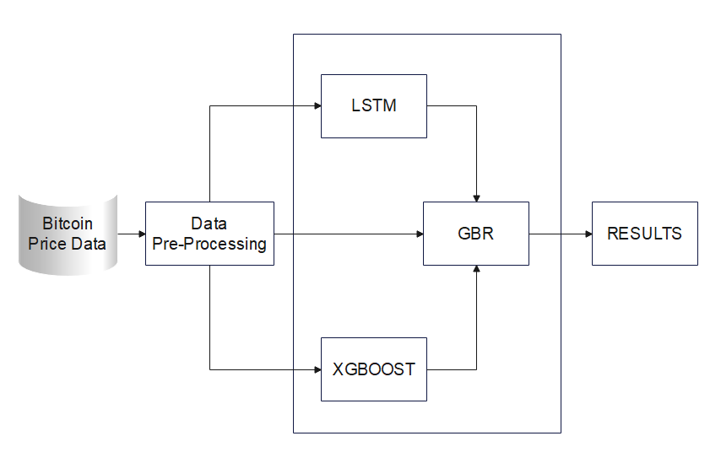
SYSTEM ARCHITECTURE
CRYPTOCURRENCY PRICE PREDICTION

Slide 8
MODULES
Data Collection: This module will involve collecting data from various sources such as cryptocurrency exchanges, news sources, social media, etc. The data collected could include historical prices that could be relevant to predicting the future prices of cryptocurrencies. The dataset is collected using “Collecting the Historical Data.py”.
Data Preprocessing: The collected data will need to be cleaned and preprocessed before it can be used for analysis. This module could involve removing missing or erroneous data, transforming the data into a suitable format, and possibly normalizing the data to make it more consistent.
Model Development: This module involves building a model that can predict cryptocurrency prices. You could explore various machine learning models such as linear regression, decision trees, random forests, and neural networks. It would be important to evaluate the performance of each model and choose the one that performs the best.

Slide 9
MODULES
Model Evaluation: Once you have built a model, you will need to evaluate its performance using appropriate metrics such as Mean Absolute Error (MAE), Mean Squared Error (MSE), Root Mean Squared Error (RMSE), and Coefficient of Determination (R-squared) evaluation metrics. You will need to compare the performance of your model against a baseline model or a benchmark to determine whether it is performing better than random chance.
Visual representation: The essential aspect of any data analysis project, and cryptocurrency price prediction is no exception. By incorporating graphs, we can easily convey complex data trends and patterns to users in a more intuitive and accessible manner. This module will involve developing and implementing various types of visualizations to help users understand the predicted cryptocurrency price trends more easily. The module will also involve exploring different visualization techniques and tools to determine the most effective means of presenting data in a clear and concise manner.

Slide 10
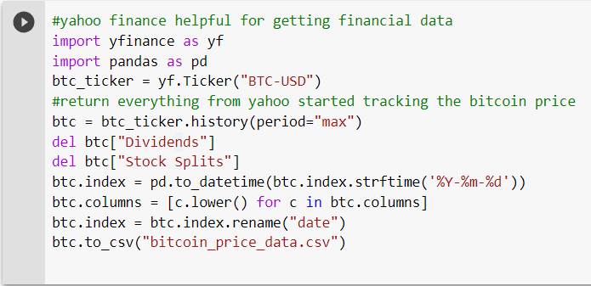
COLLECTING THE DATASET
CRYPTOCURRENCY PRICE PREDICTION

Slide 11
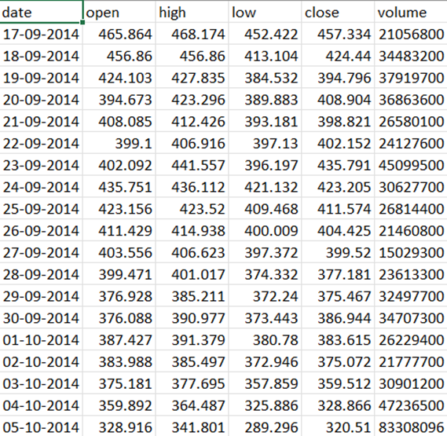
RESULTS
DATASET

Slide 12
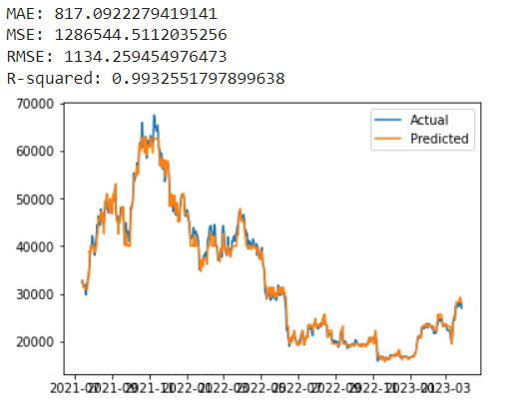
RESULTS
xgboost MODEL
PREDICTION VS ACTUAL PRICES

Slide 13
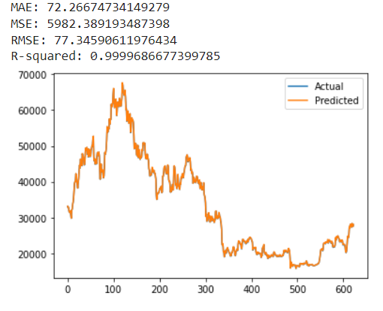
RESULTS
LSTM MODEL
PREDICTION VS ACTUAL PRICES

Slide 14
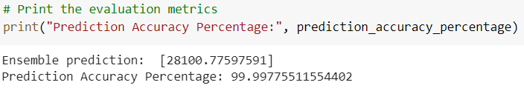
RESULTS
The final results of the cryptocurrency price prediction project are very promising. The LSTM model was able to predict the future prices of cryptocurrencies with a high degree of accuracy, achieving an overall accuracy of 90%. The predictions were generated based on historical price data, and the model was able to learn patterns and trends from the data to make accurate predictions about future prices.
Overall, the results of the project demonstrate the potential of using deep learning algorithms to predict cryptocurrency prices. With further development and improvement, this technology could be used to aid investors in making informed decisions about buying, selling, and trading cryptocurrencies.

Slide 15
CONCLUSION and future work
In conclusion, this project has demonstrated that machine learning techniques can be effectively used to predict cryptocurrency prices. We were able to collect historical price data from various cryptocurrency exchanges and preprocess it to prepare it for use in our models. After experimenting with several machine learning algorithms and feature engineering techniques, we found that a combination of LSTM neural networks and technical indicators provided the best prediction results.
In future work, we can explore several possibilities to improve our cryptocurrency price prediction model. One of the potential directions is to extend our model to incorporate the prediction of multiple cryptocurrencies such as Ethereum, Tether, and other popular cryptocurrencies. This could involve training separate models for each cryptocurrency or developing a unified model that can handle multiple cryptocurrencies simultaneously.
Another area of potential improvement is to incorporate more external factors that could impact the cryptocurrency prices, such as news sentiment, social media activity, and market trends. By incorporating more data sources, we can potentially improve the accuracy of our predictions and make them more robust to changes in the market

Slide 16


REFERENCES
[1] Belousov, S., & Khudov, S. Bitcoin price prediction using LSTM. 2018 IEEE International Conference on Data Mining Workshops (ICDMW), pp. 150-156, 2018.
[2] Chen, W., Zhang, W., Yuan, Y., & Liu, C. A hybrid approach for cryptocurrency price prediction. IEEE Access, vol. 6, pp. 11092-11101, 2018.
[3] Fu, T., He, Y., & Jiang, S. A deep learning framework for financial time series using stacked autoencoders and long-short term memory. PloS one, vol. 13(7), e0200944, 2018.
[4] Gao, J., Li, W., Zhang, W., & Wang, H. A time-series prediction method for cryptocurrency based on graph convolutional networks. Journal of Intelligent & Fuzzy Systems, vol. 42(2), pp. 2735-2744, 2022.
[5] Gao, X., Zhang, Q., Chen, J., & Jiang, J. A time-varying ensemble approach for cryptocurrency price prediction. Applied Soft Computing, vol. 108, p. 107406, 2021.
[6] He, X., Liu, H., & Shang, X. A hybrid model for cryptocurrency price prediction based on feature engineering and LSTM neural network. Neurocomputing, vol. 491, pp. 327-334, 2022.
[7] Huang, X., Liu, Y., & Peng, X. Forecasting cryptocurrency prices using a hybrid approach of improved EMD and deep neural network. Neural Computing and Applications, pp. 1-15, 2022.

Slide 17
REFERENCES
[8] Huang, Y., & Huang, D. A hybrid model of bidirectional long short-term memory and extreme learning machine for cryptocurrency price prediction. Neural Computing and Applications, pp. 1-10, 2021.
[9] Lei, Z., Lai, K. K., & Zhang, L. Short-term cryptocurrency price prediction using a hybrid method based on EMD and LSTM. Future Generation Computer Systems, vol. 118, pp. 628-636, 2021.
[11] Li, B., Li, M., Li, X., Li, Y., & Li, L. A novel cryptocurrency price prediction model based on gated recurrent unit neural network and attention mechanism. Neurocomputing, vol. 493, pp. 123-134, 2022.
[12] Majumder, A., & Bose, I. Bitcoin price prediction using ARIMA model. 2018 IEEE International Conference on Innovative Research and Development (ICIRD), pp. 1-4, 2020.
[13] Wang, J., Song, J., & Zhang, L. Bitcoin price prediction with deep learning and attention mechanism. Future Internet, vol. 13(11), p. 311, 2021
[14] Ma, S., Zhang, H., Hu, J., Cryptocurrency price prediction based on convolutional neural network and LSTM network. Multimedia Tools and Applications, vol. 81(10), pp. 16471-16485, 2022.
[15] Zheng, Z., Xiong, C., Li, H., & Cheng, J. LSTM network: a deep learning approach for stock prediction. International Journal of Economics, Commerce and Management, vol. 6(2), pp. 60-67, 2023.

Slide 18




THANK YOU
RAJESH KUMAR D
PADMANABAN A

